Slide 1
PY620 -Class 3
Normal distribution
  Central Limit Theorem
  Standard scores
Probability: definitions
  Mutually exclusive
  Conditional probability
  Independent events
Law of "at least one"
Binomial distribution
Exercises.
Coin Jar Calculator.
SPSS

Slide 2
Inferential Statistics: a Definition Revisited.
Inferential Statistics are used to determine the probability (or likelihood) that a conclusion based on analysis from a sample is true.
All measurement contains random error.
We need to take this random error into account when we are trying to say something about a population based on a sample.
High School graduating class. Would a random sample of 10 students characterize your HS class as well as a random sample of 50? Maybe, but probably not.

Slide 3
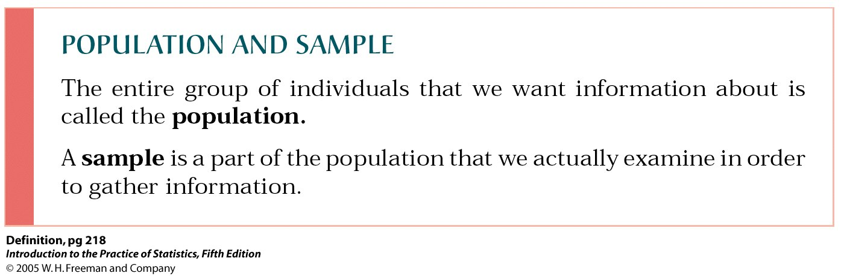
Difference between Samples and Populations.
The sample describes those individuals who are in a study; the population describes the hypothetical (and usually) infinite number of people to whom you wish to generalize.
Defining the population of interest is very important. Only if the population is well defined can you successfully sample from it.

Slide 4
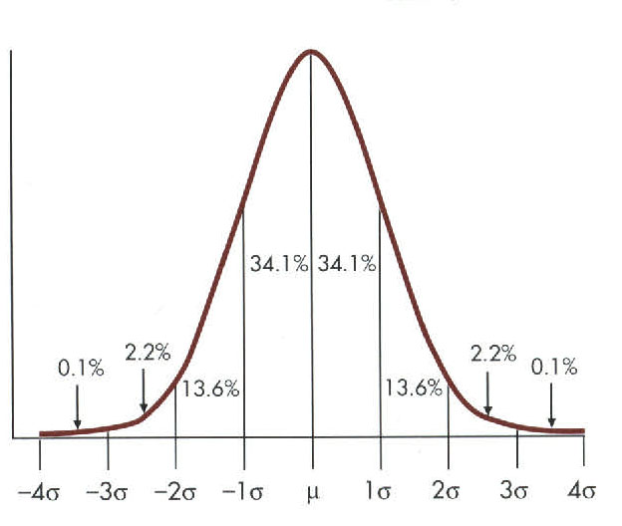
Normal distribution
Also known as Gaussian distribution.
Provides the basis for many inferential statistics.
Theoretical distribution that is defined in terms of a mathematical function referred to as the normal probability density function.

Slide 5
Normal Distribution: more facts
It is a continuous distribution that contains values ranging from negative infinity to positive infinity.
The normal distribution is bell-shaped, unimodal, and symmetrical.
The mean, median, and mode all have the same value.

Slide 6
Normal Distribution
The percentage of observations within any given interval can be determined. Approximately 68% of the observations fall within one standard deviation above and below the mean, approximately 95% of the observations fall within two standard deviations above and below the mean, and over 99% of all observations fall within 3 standard deviations above and below the mean.

Slide 7
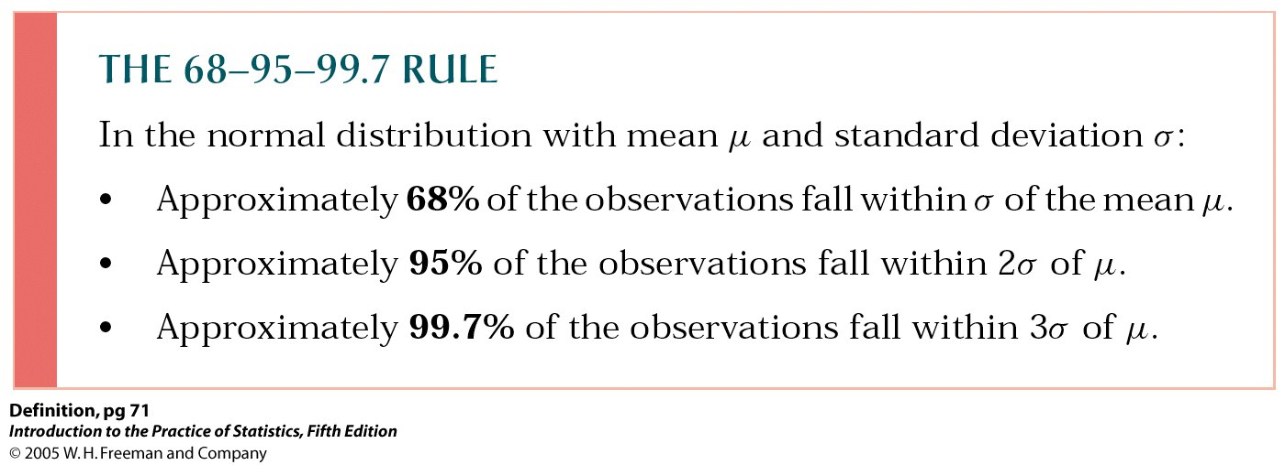

Slide 8
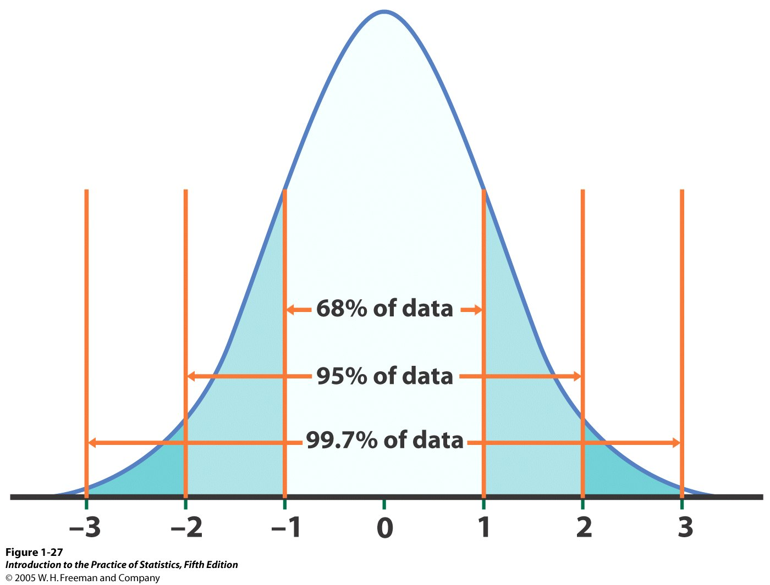

Slide 9
Many naturally occurring distributions are normally distributed
A number of naturally occurring distributions are approximately normally distributed.
  The distribution of certain human characteristics, such as height, weight, IQ, and serum cholesterol is approximately normally distributed.
  The distribution of errors, such as errors of measurement or discrimination.
  It should be pointed out that the normal distribution cannot be considered “nature’s rule,” since many naturally occurring distributions do not resemble a normal distribution.

Slide 10
Good approximation for other distributions
A second reason that the normal distribution is important is that it serves as a good approximation for a number of other theoretical distributions that are difficult or impossible to define precisely.
For example, the binomial distribution, which is used to determine the likelihood of a given outcome over a series of successive trials, is frequently approximated by the normal distribution. This significantly reduces the calculations required to perform the test.

Slide 11
Central limit theorem.
A third reason that the normal distribution is important has to do with sampling and a principle known as the central limit theorem.
Consider a case where a large number of samples of size N were drawn from the same finite population, the mean of each sample was calculated, and these means were used to form a new distribution of means (referred to as the sampling distribution of means).
The central limit theorem states that, regardless of the form of the original distribution, the distribution of means will be approximately normal when N is large. This principle provides the foundation for interval estimation and a variety of inferential statistics including t-tests and analysis of variance.

Slide 12
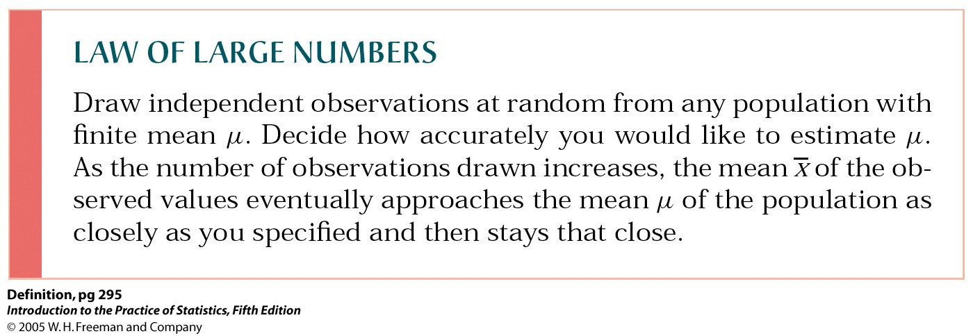
Law of Large Numbers
Basically, the average of a sample is likely to be close to the average of the population from which it is drawn.

Slide 13
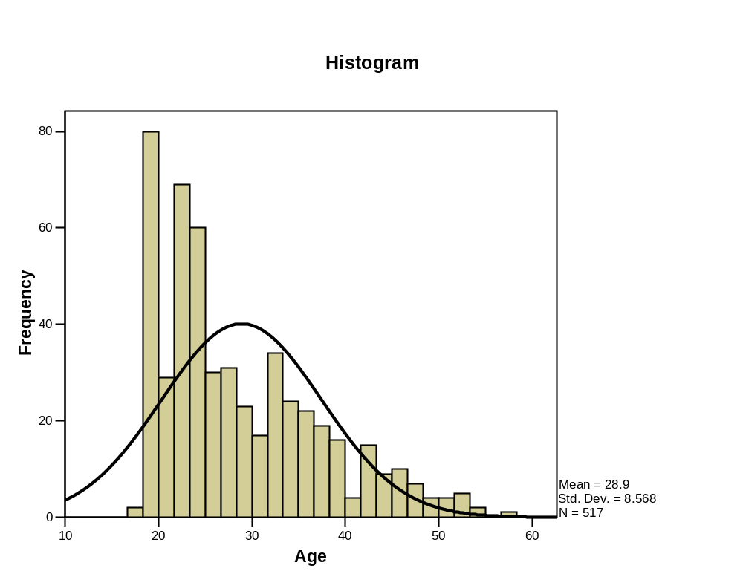
NG- Age distribution

Slide 14
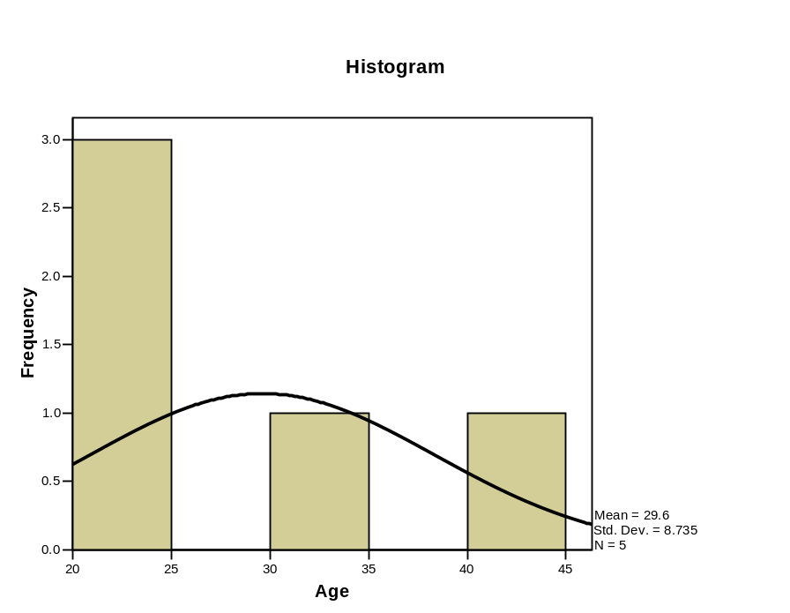
Population vs. 1% sample

Slide 15
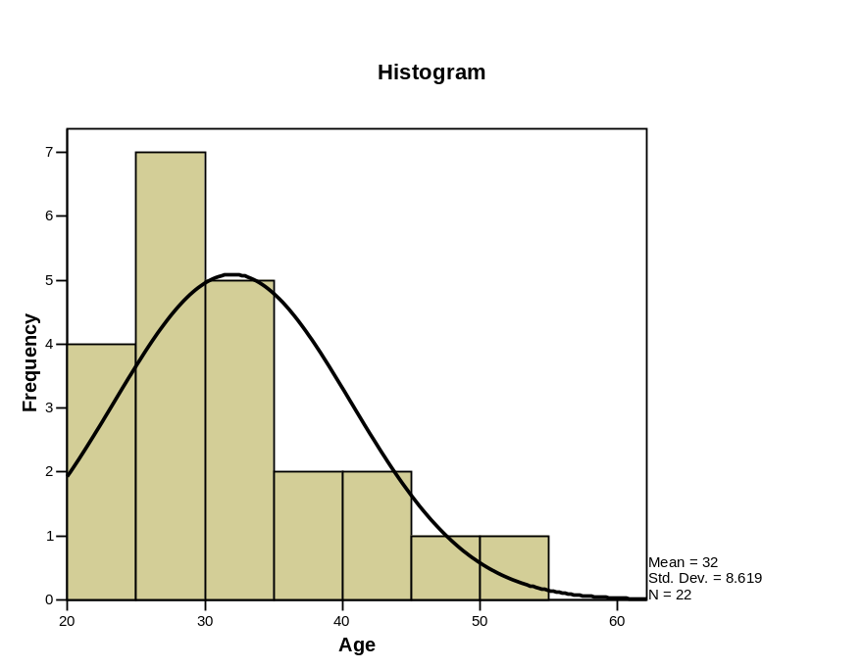
Population vs. 5% sample

Slide 16
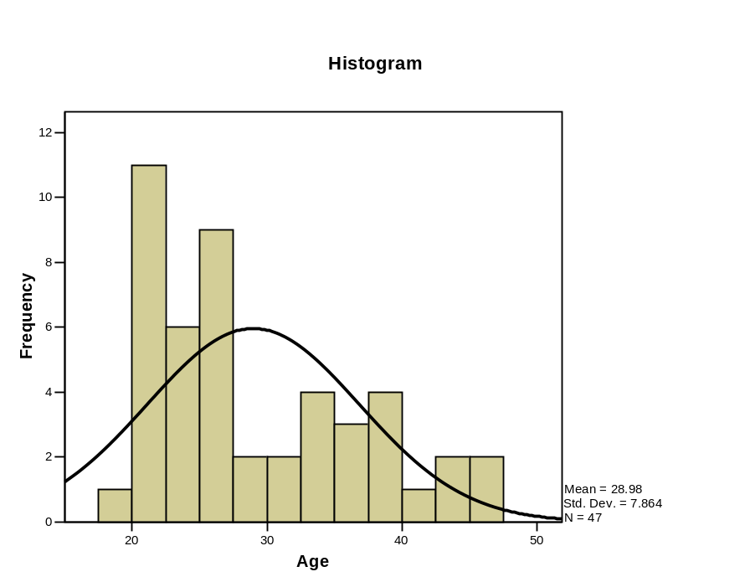
Population vs. 10% sample

Slide 17
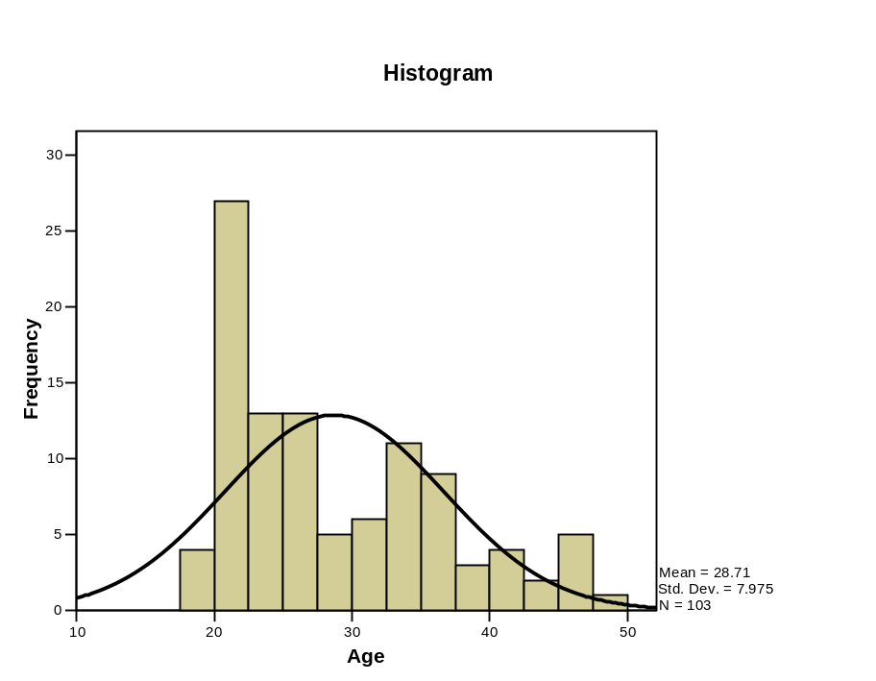
Population vs. 20% sample

Slide 18
Direct links to probability.
A fourth reason that the normal distribution is important has to do with its direct links to probability.
Recall that the percentage of observations can be determined in a normal curve for any given interval. Also, keep in mind that probability is defined in terms of the long-run relative frequency of occurrence of an event. Given these considerations, then what is the probability of randomly drawing an observation from a normal curve that is within 1 standard deviation above or below the mean? The answer is given in terms of the relative frequency of that event if we were to draw a random observation over a large number of trials. Since approximately 68% of all observations in a normal curve fall within this interval, then the probability of that event is approximately .68.

Slide 19
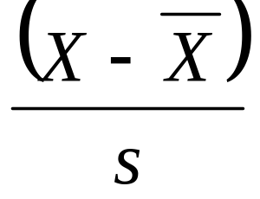
Standard Scores
Standard scores ,usually abbreviated as z or Z, is a way of expressing any raw score in terms of standard deviation units.

Slide 20
Standard Scores: Class Height
Subject | height | average height | difference | Standard Deviation | z
1 | 67 | 62.7 | 4.3 | 5.229 | 0.82218
2 | 62 | 62.7 | -0.7 | 5.229 | -0.13384
3 | 70 | 62.7 | 7.3 | 5.229 | 1.395793
4 | 54 | 62.7 | -8.7 | 5.229 | -1.66348
5 | 64 | 62.7 | 1.3 | 5.229 | 0.248566
6 | 55 | 62.7 | -7.7 | 5.229 | -1.47228
7 | 60 | 62.7 | -2.7 | 5.229 | -0.51625
8 | 68 | 62.7 | 5.3 | 5.229 | 1.013384
9 | 64 | 62.7 | 1.3 | 5.229 | 0.248566
10 | 63 | 62.7 | 0.3 | 5.229 | 0.057361
sum | 627 | 627 | 0 |  | 0
sum/N | 62.7 | 62.7 | 0 |  | 0

Slide 21
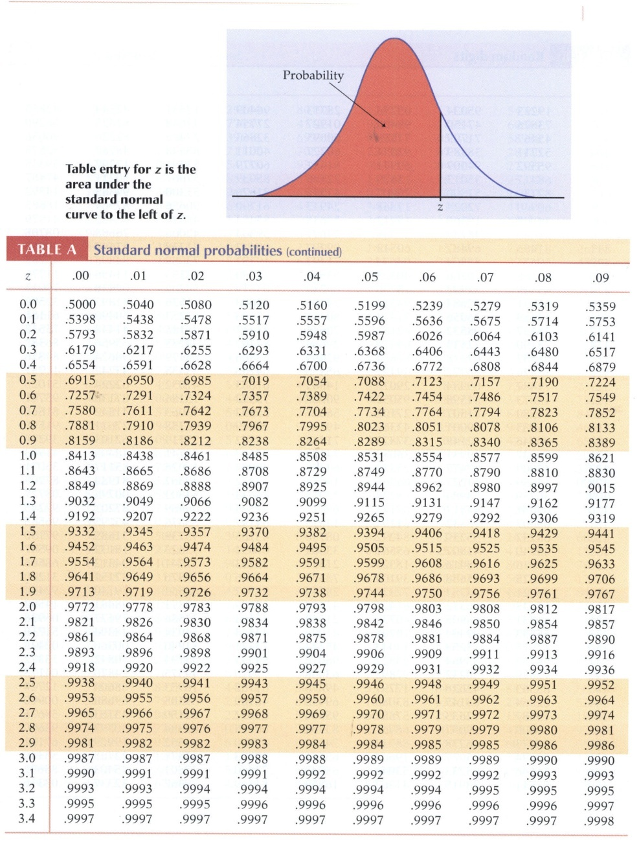
Z distribution
You can check the z scores against the z distribution to see where they fall.
For instance a z score of 1.39 means that 90% of the class are shorter than that person.

Slide 22
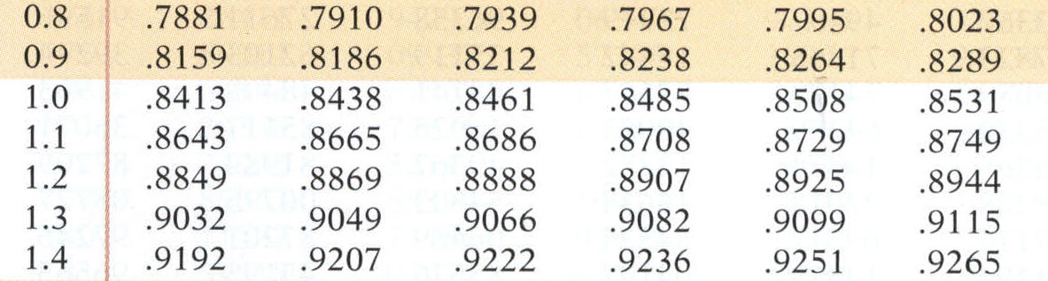
Reading the Z-distribution table.
For a Z value of 1.25, we can find the distribution by going to the 1.2 row and then reading down the column marked .05.
A value of .8925 means that 89.25% of the distribution has a lower score and only 10.75 percent of the distribution as a higher score.

Slide 23
Probability
Probability deals with the relative likelihood that a certain event will or will not occur, relative to some other events.
Empirically derived (many trials).
Theoretically derived (dice rolls, card hands, etc).

Slide 24
Mutually exclusive events
Two events , X and Y, are mutually exclusive if the occurrence of one precludes the occurrence of the other.
Examples: Coin flip, vote.
Additive rule: if X and Y are mutually exclusive events, then the probability of X or Y is the probability of X plus the probability of Y.

Slide 25
Conditionally Dependent Events
Two events, X and Y, are conditionally dependent if the outcome of Y depends on X, or X depends on Y.
Multiplicative Law
  If X and Y are conditionally probable, then the probability that both will occur is the probability of X times the probability of Y, given X has occurred.

Slide 26
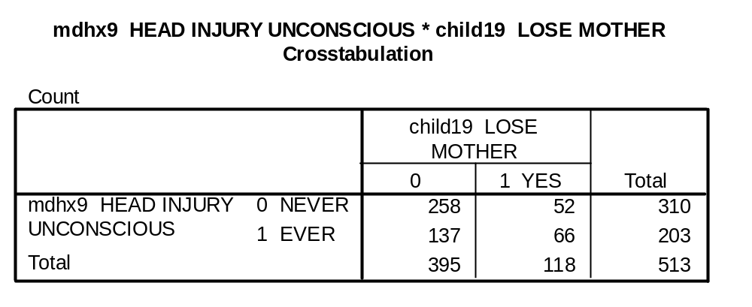
Conditional probability: Loss of mother in childhood and traumatic brain injury
What is the probability of having a brain injury and having lost your mother during childhood?

Slide 27
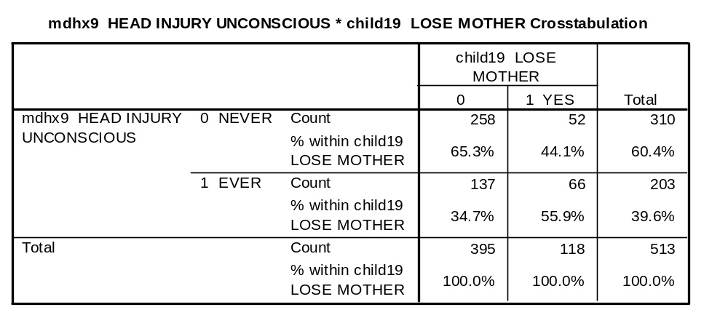
What is the probability of having a head injury?
In this sample (folks with substance abuse problems) it is 39.6%

Slide 28
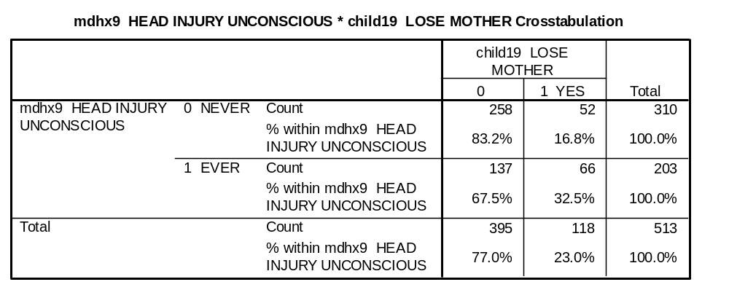
What is the probability of having a head injury if you lost your mother in childhood?
The probability of having lost your mother as a child if you have had a brain injury is 32.5%.

Slide 29
Bringing it together
Therefore, in this sample, the probability of having a head injury and having lost your mother as a child is:
.396 (probability of head injury) times
.325 (probability of head injury if mother was lost in childhood).
=.129 of 12.9% or 66/513

Slide 30
Independent Events
Many events are independent . Each occurrence is independent of previous occurrences.
Conditional events depend on the occurrence of a previous event.
If nine coin flips are heads, what is the probability that the tenth will be heads?
Of these types of gambling which are independent and which are conditional?
  Lottery
  Blackjack
  Roulette
  Texas Hold-em

Slide 31
Law of “at least one”
Every test has a false-positive rate. This chance of a false test can add up.
If a test has a false positive rate of 5%, what is the likelihood that at least one test will be false after 20 tests.
Formula= 1-Pr(none)^{number of tests.} 1-.95²⁰
1-.358=64.2%.
More than 50% chance of positive test.

Slide 32
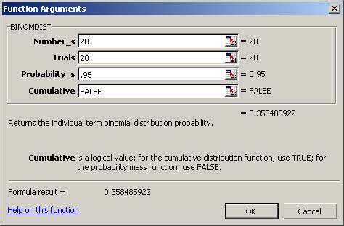
This function in Excel tells us the likelihood of having NO false positives in 20 trials of a test with an accuracy rate of .95 or 95%.

Slide 33
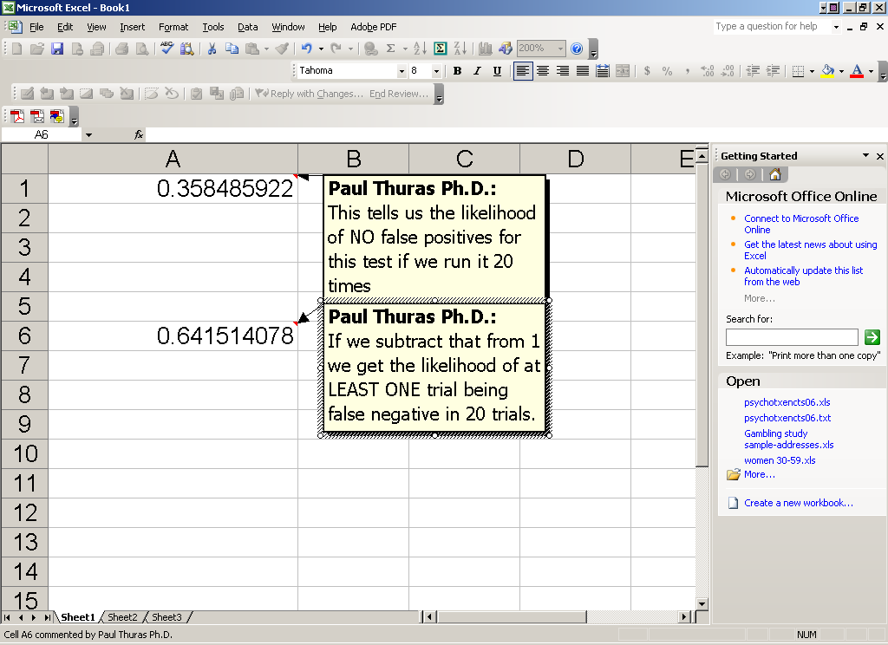

Slide 34
Binomial Distribution
If continuous measures get the normal distribution, is there a distribution for binomial (yes/no) outcomes?
The binomial distribution shows the probabilities of different outcomes for a series of random events, each which can have only one of two values.

Slide 35
Binomial Distribution
Applicable when:
Series of independent trials (e.g., flips of coins) where the outcome of 1 trial does not influence the outcome of another
Each trial can result in only 1 of 2 possible outcomes (e.g., heads or tails, six or not six)
The probability of success is constant from trial to trial.

Slide 36
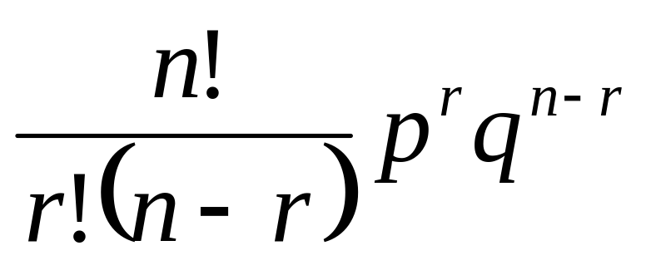
Binomial expansion
N = # trials
r = # successes
p = probability of success on a single trial
q = probability of failure on a single trial
Pr(r successes on N trials) =
Note that p + q = 1 and that q = 1 - p

Slide 37
Binomial Expansion:
Not as scary as it looks.
What is the likelihood of a professor getting to work on time exactly 7 times out of 10 if, on any given day, he has a 60% likelihood.
Number of tries (n)=10.
Number of favorable outcomes (r) =7.
Probability on each try (p) =.6
q=1-p (1-.6 =.4).

Slide 38
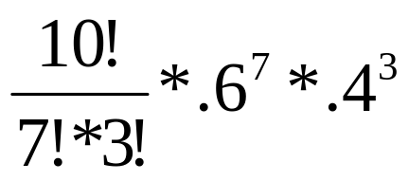
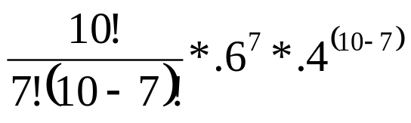
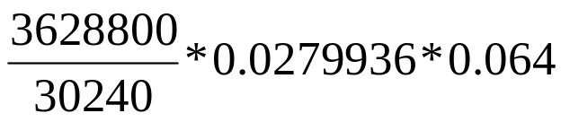
We plug in all of the numbers….
10!=3628800
7! * 3! =
5040*6=30240
.6⁷=0.0279936
.4³=0.064
=21.5% Likelihood of said professor getting to work on time exactly 7 days out of 10.

Slide 39
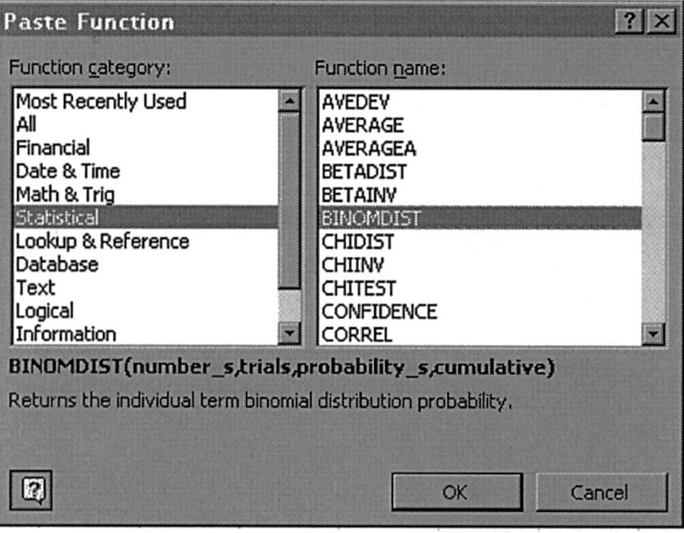

Software commands: Excel:
=BINOMDIST (number_s, trials, probability_s, cumulative)
Number_s:
number of successes in trials.
Trials:
number of independent trials.
Probability_s:
probability of success on each trial.
Cumulative:
a logical value that determines
the form of the function.
  TRUE, or 1, for the cumulative
  P(X ≤ Number_s)
  FALSE, or 0, for the probability
  function P(X = Number_s).

Slide 40
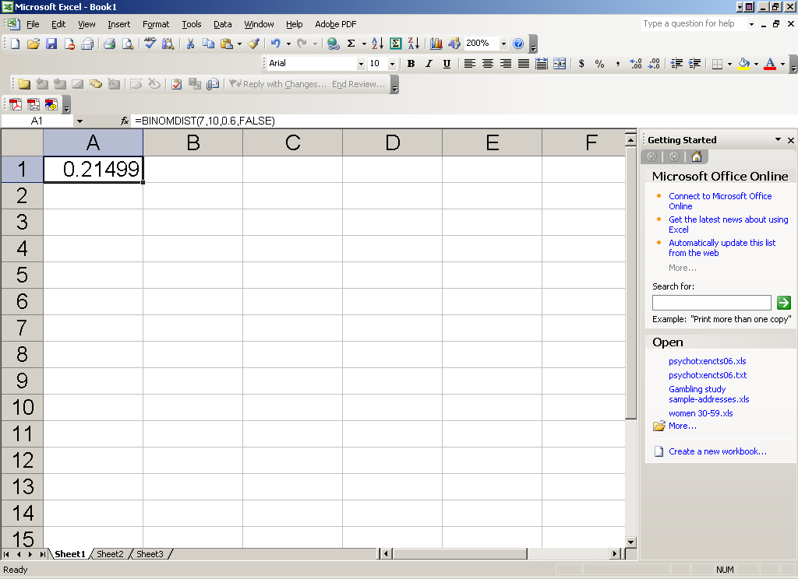


Slide 41

Binomial Distribution Properties
Mean=np
Variance=npq
SD=
Mean for last problem = 10 x .6 =6.
Variance=10 x .6 x .4=2.4
SD=sqrt 2.4=1.55
As sample size gets larger, the binomial distribution approximates the normal distribution. As Martha says, "it's a good thing".

